Slide 1
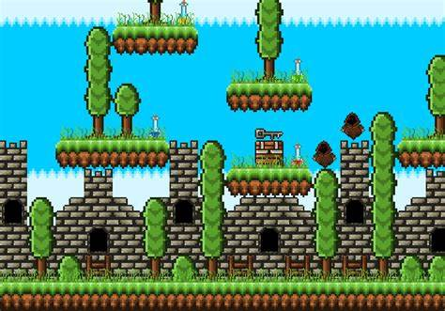
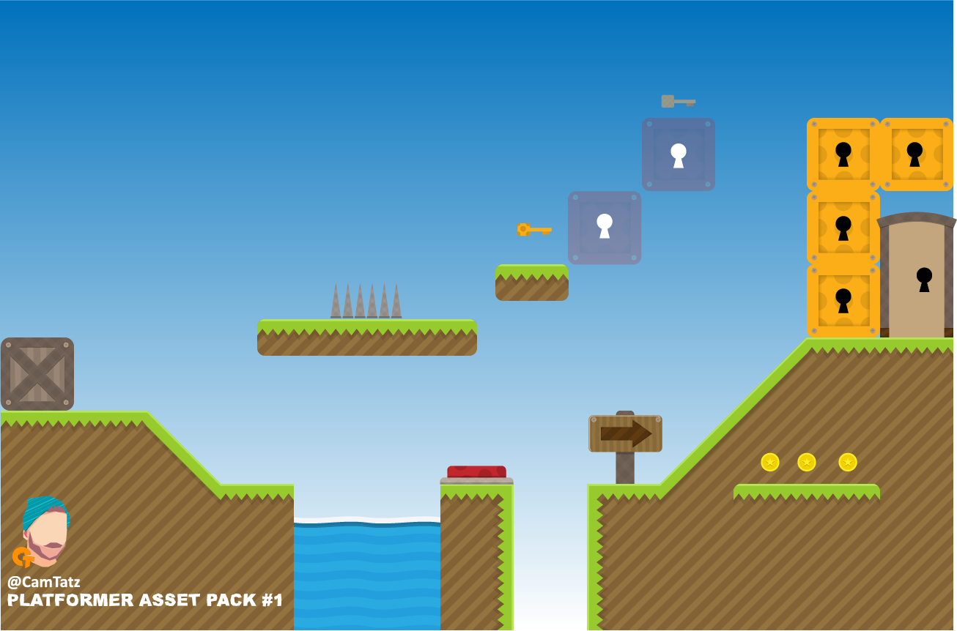
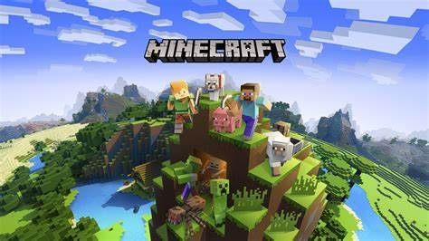
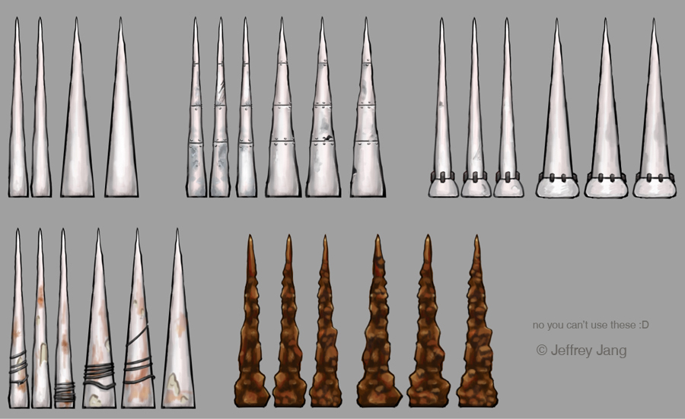
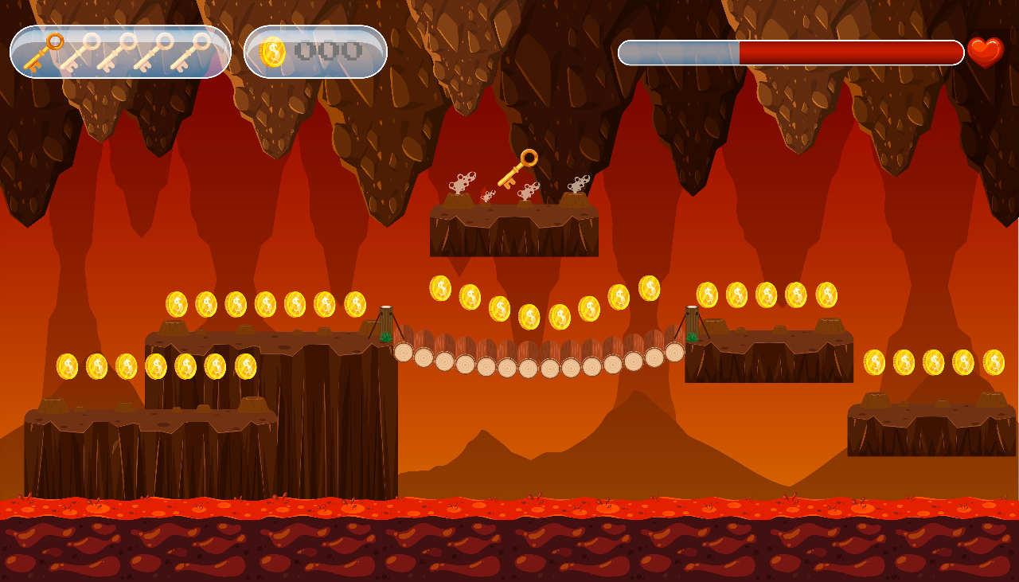

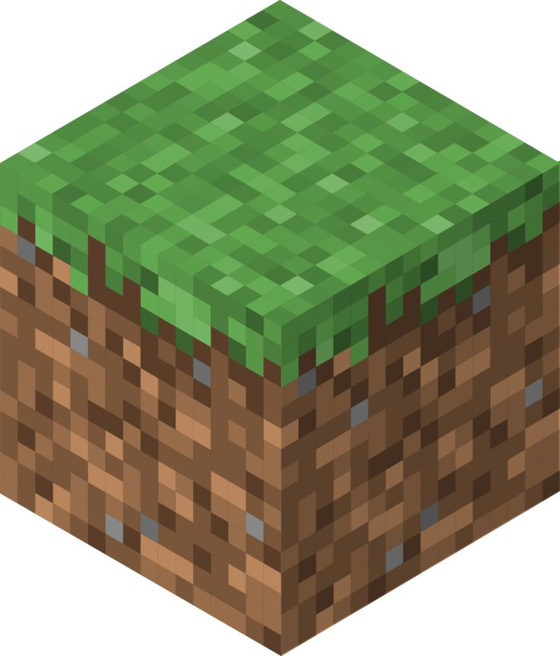
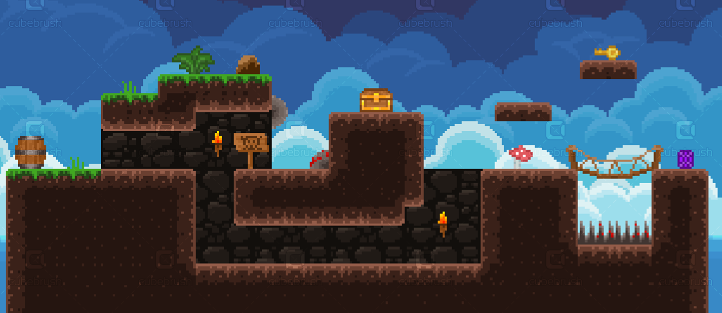
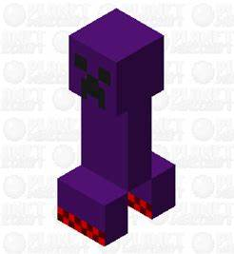



Slide 2
pygame
Space bar
Left arrow
Right arrow
puzzle
python
controls
program
genre
Lava
Avoid obstacles
parkour
enemies
Video game
Minecraft themed
Aim of game
Collect diamonds
Male and female
Target audience
global
Pass levels
colours
8 – 12-year-old
Dark themed
Less vibrant colours
Purple

Slide 3
controls
python
parkour
Lava
Avoid obstacles
Video game
Minecraft themed
enemies
Aim of game
Collect diamonds
8 – 12-year-old game
Pass levels
Dark themed

